Slide 1
Ensemble Learning

Slide 2
How to Improve Results?
Choice of Model
Feature Engineering
Missing Values
Feature Scaling
Hyper-parameter tuning

Slide 3
Improving Results Even More
Combine the power of multiple models
This is called Ensemble method.
To define Ensemble methods is a machine learning technique that combines several base models in order to produce one optimal predictive model.

Slide 4
Ensemble Methods - Bagging
Use subsets of training data to train multiple models
samples are drawn with replacement
Subsets may have have duplicate training sample
All models perform prediction for Test Sample
Voting scheme is used for final classification

Slide 5
Ensemble Methods - Boosting
Boosting is also known as a scheme where weak learners are converted to strong learners.
Assign weights to training samples
Train a model using a sampling scheme where weights are taken into account for selection.
Once a classifier is done with training, weights of “incorrectly classified” samples are updated
Model is now re-trained so it can improve its classification strategy
Process continues until desired performance is achieved or improvement stops.

Slide 6
Ensemble Methods - Random Forest Approach
Multiple Models containing random set of features.
Often paired with bagging approach

Slide 7
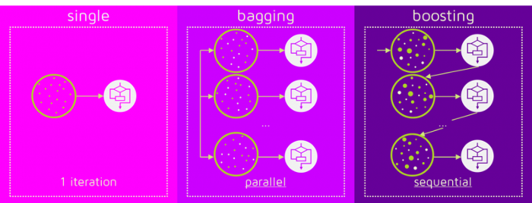

Slide 8
Stacking
Stacked Generalization or “Stacking” for short is an ensemble machine learning algorithm
Stacking addresses the question that:
Given multiple machine learning models that are skillful on a problem, but in different ways, how do you choose which model to use ?

Slide 9
Stacking - Example
The architecture of a stacking model involves two or more base models, and a meta-model that combines the predictions of the base models
Base-Models: Models fit on the training data and whose predictions are compiled.
Meta-Model: Model that learns how to best combine the predictions of the base models.
For example, for a classification problem, we can choose as
Base Models: a KNN classifier, a logistic regression and a SVM,
Meta Model: a neural network.
the neural network will take as inputs the outputs of our three weak learners and will learn to return final predictions based on it.

Slide 10
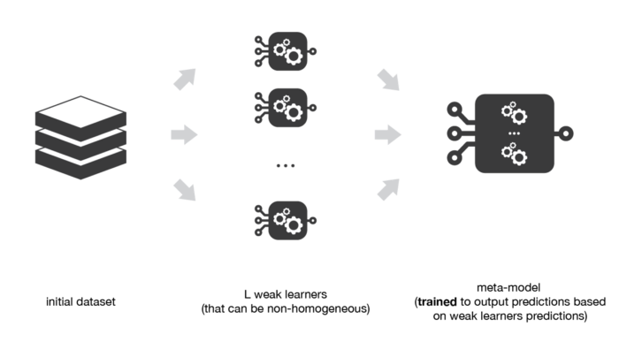
Stacking

Slide 11
How is Stacking Different?
Unlike bagging, in stacking, the classifiers are typically different
In stacking classifiers are trained on the same dataset (e.g. instead of samples of the training dataset).
Unlike boosting, in stacking, a single model is used to learn how to best combine the predictions from the contributing models (e.g. instead of a sequence of models that correct the predictions of prior models).

Slide 12
Stacking - continued
The outputs from the base models used as input to the meta-model may be real value in the case of regression, and probability values, probability like values, or class labels in the case of classification.
The meta-model is trained on the predictions made by base models on out-of-sample data.
data not used to train the base models is fed to the base models,
predictions are made, and
these predictions, along with the expected outputs, provide the input and output pairs of the training dataset used to fit the meta-model.

Slide 13
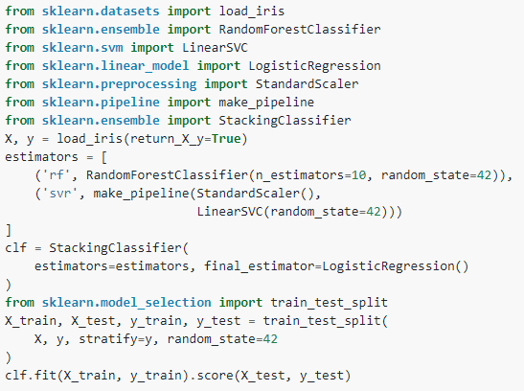
Stacking – SciKit-Learn
Stacking is provided via the StackingRegressor and StackingClassifier modules in sk-learn

Slide 14
References & Learning Resources
https://towardsdatascience.com/ensemble-methods-in-machine-learning-what-are-they-and-why-use-them-68ec3f9fef5f
https://scikit-learn.org/stable/modules/generated/sklearn.ensemble.BaggingClassifier.html
https://machinelearningmastery.com/stacking-ensemble-machine-learning-with-python/
https://scikit-learn.org/stable/modules/generated/sklearn.ensemble.StackingRegressor.html
https://scikit-learn.org/stable/modules/generated/sklearn.ensemble.StackingClassifier.html

Slide 15
Additional Slides

Slide 16
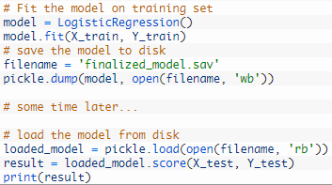
Exporting Trained Models for Use
Notes:
The pickle API for serializing standard Python objects.
The joblib API for efficiently serializing Python objects with NumPy arrays.

Slide 17
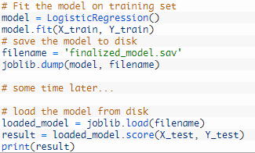
Exporting Trained Models for Use
Notes:
The pickle API for serializing standard Python objects.
The joblib API for efficiently serializing Python objects with NumPy arrays.

